Slide 1
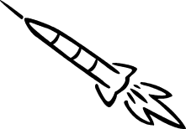

Mid Body Laser Designated Guidance Section Design
January 6th, 2008
Team Carpe Noctem
TDC1 FALL

Slide 2
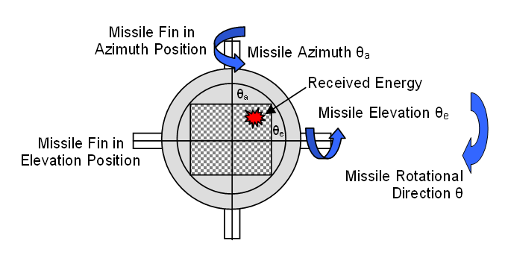
Problem Statement
Customer requests stability analysis for laser guided missile
Design control system if missile is unstable
Requirements for Stability
  Less then 20% Over Shoot
  Reaches 2% Final Value in 0.6 Seconds
TDC1 FALL

Slide 3
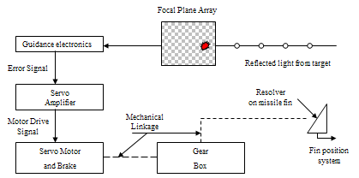
System Description
System Diagram provided by customer showcasing control system components
TDC1 FALL

Slide 4

Missile Selection
AIM-7F/M Sparrow
Primary function: Air-to-Air missile
Dimensions: Length 12 ft., Diameter 8 in., Wingspan 3 ft. 4 in.
Speed: 782.32 m/s
Range: 32186.88 m → 22531.0 m
TDC1 FALL

Slide 5
Chosen Missile Model
PANNING IN ELEVATION
Adjusting collinear fins in elevation angle
Cross-coupling will exist b/w Az & El
TDC1 FALL

Slide 6
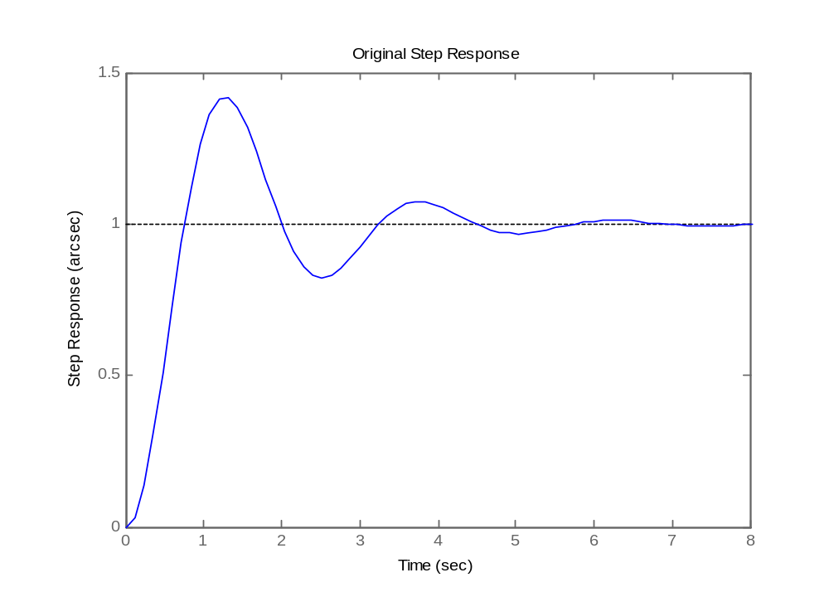
Original System Step Response
> 40% Overshoot
> 5 sec Settling Time
>.6 sec Rise Time
NO GOOD.
TDC1 FALL

Slide 7
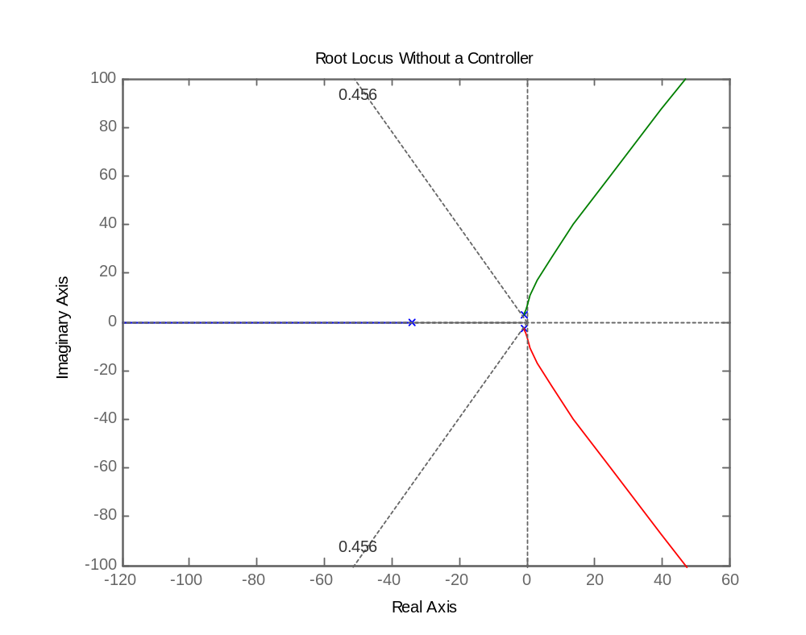
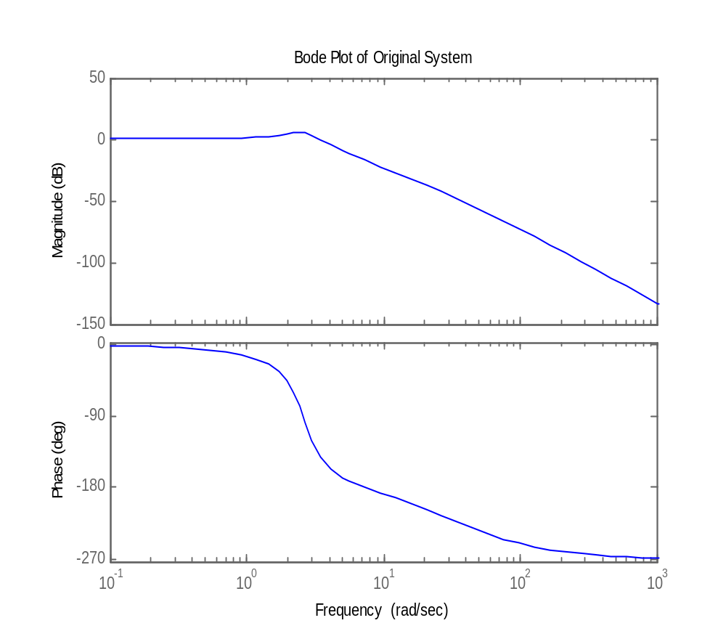
RL & BP of Original System
Slow response or instability seen at almost all K values of current system.
High frequency attenuation means slow system response.
NO GOOD.
NO GOOD.
TDC1 FALL

Slide 8




Original Control System Scenario
JC
WF
N
AN
JCWF
TDC1 FALL

Slide 9
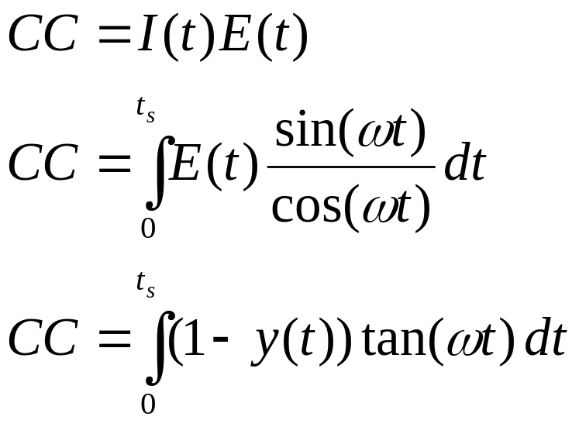
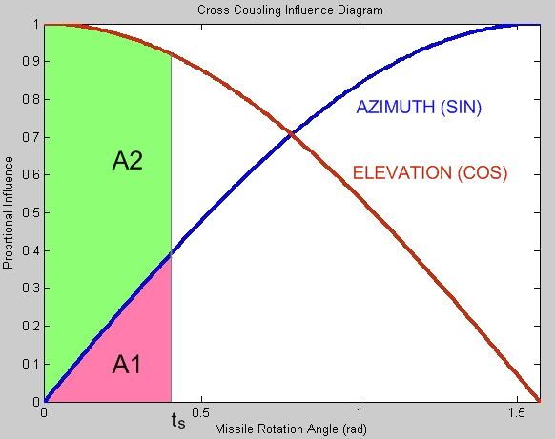
Missile Cross-Coupling
I(t), Influence Factor, set to ½.
Ratio of EL fin contribution with respect to AZ contribution.
tan (wt) = sin (wt) / cos (wt) = ½
@ .4363 rad / sample
TDC1 FALL

Slide 10
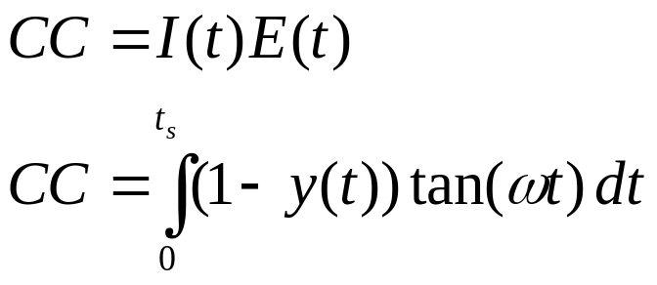
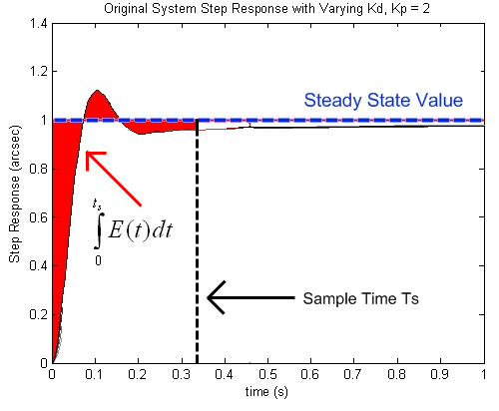
Missile Cross-Coupling
CC is quantifiable
  Based on assigned threshold
  Based on total error seen until sample time
How do we minimize E(t)?
  Minimize rise time
  Minimize settling time
TDC1 FALL

Slide 11
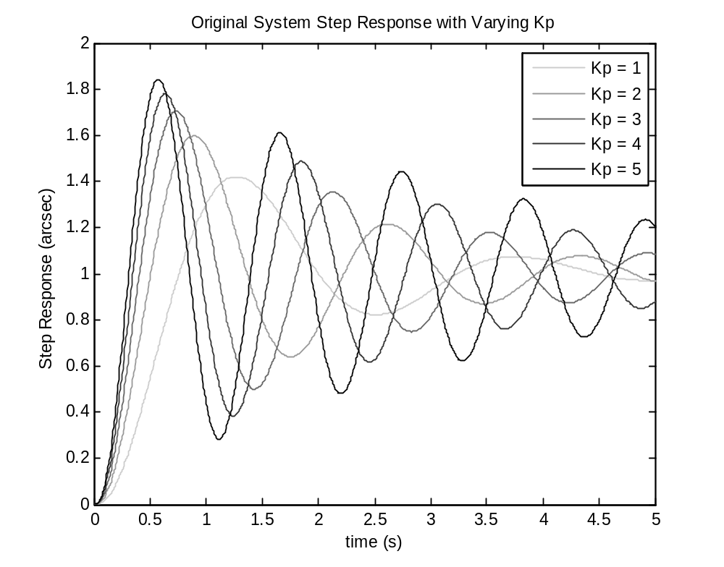
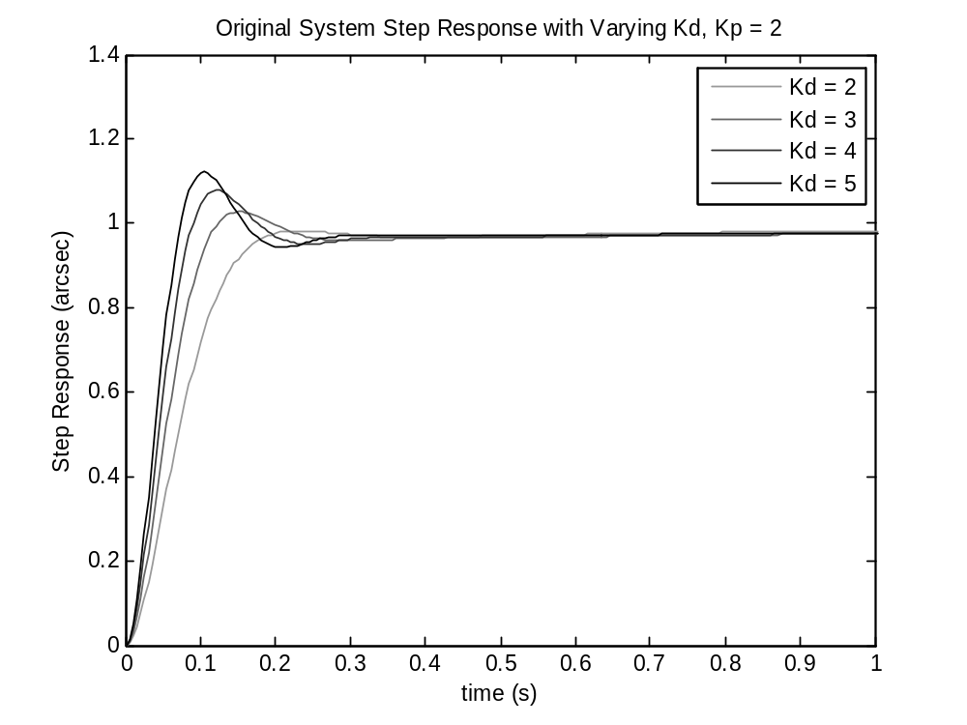
OrigSys with P & PD Control
Analysis shows that a PD controller would drive system to meet specifications!
TDC1 FALL

Slide 12
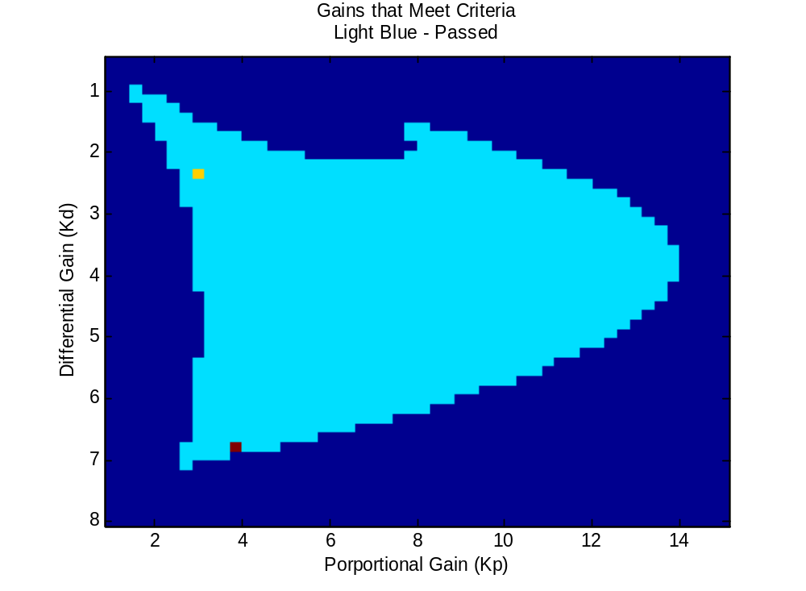
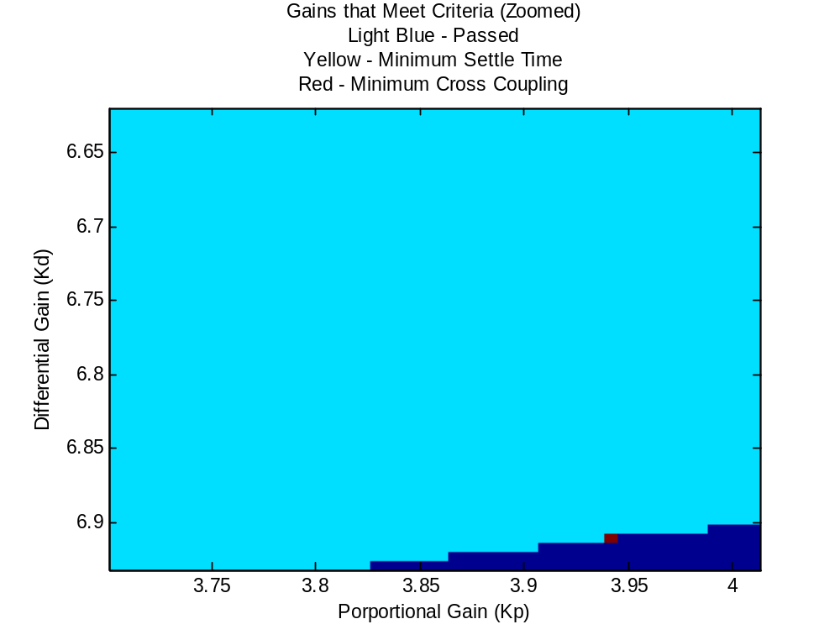
Gain Selection
Kd = 6.9098
Kp = 3.9415
Optimal manual-tuning in MATLAB performed to find Kd & Kp values
TDC1 FALL

Slide 13
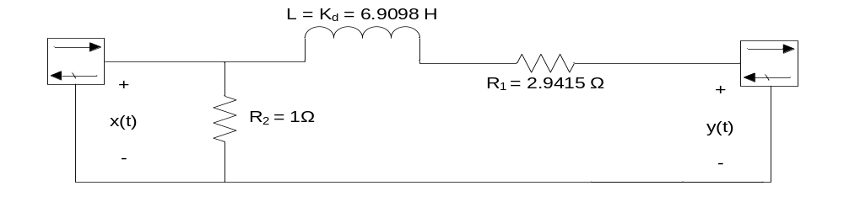
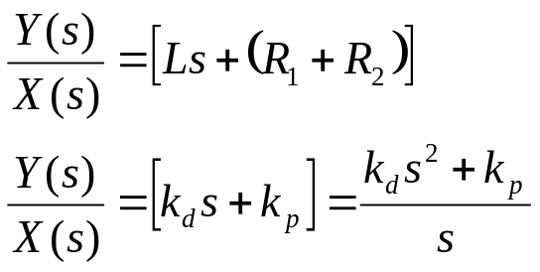



Proposed PD Controller
Circuit values derived from optimal Kd and Kp values
PD Controller built from inexpensive COTS parts
TDC1 FALL

Slide 14
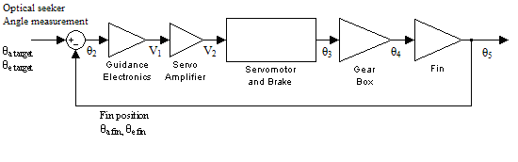
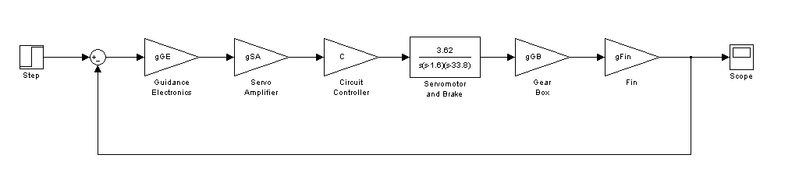
Newly Proposed Control System
Original Block Diagram of Guided Missile
New Control System Block Diagram of Guided Missile
TDC1 FALL

Slide 15
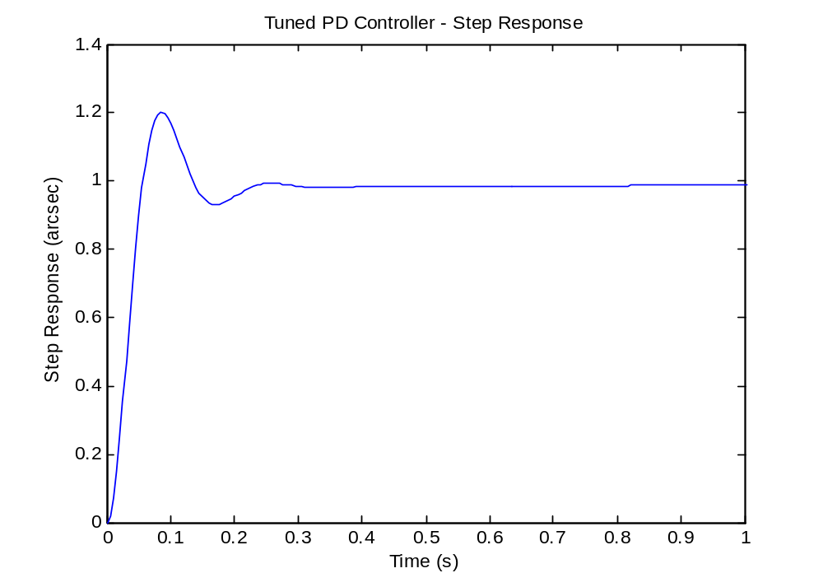
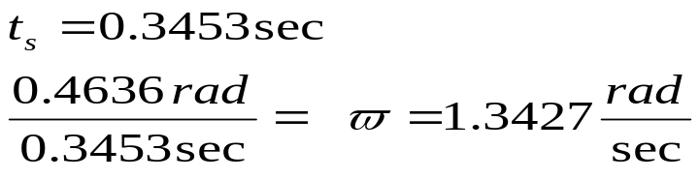
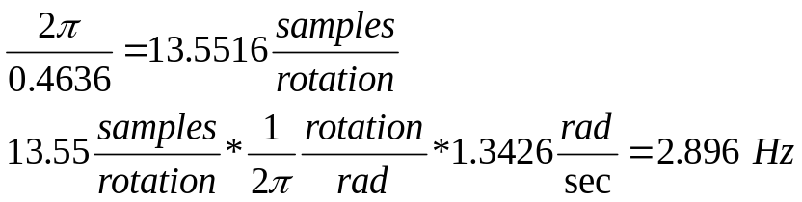
New System Step Response
Minimizing Cross-Coupling
  Minimize total rise time
  Done by maximizing overshoot (tradeoff)
Requirements
  < 20% Overshoot!
  < 0.6 sec settling time!
  Within 2% of final value!
TDC1 FALL

Slide 16
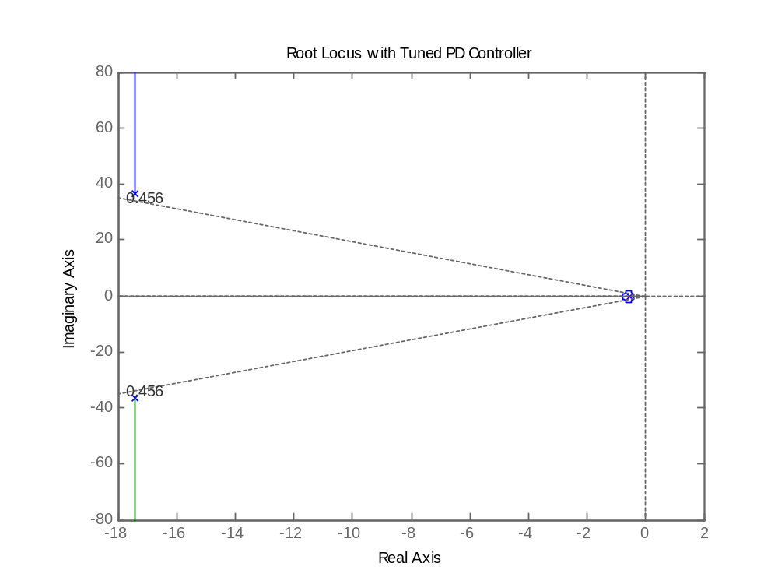
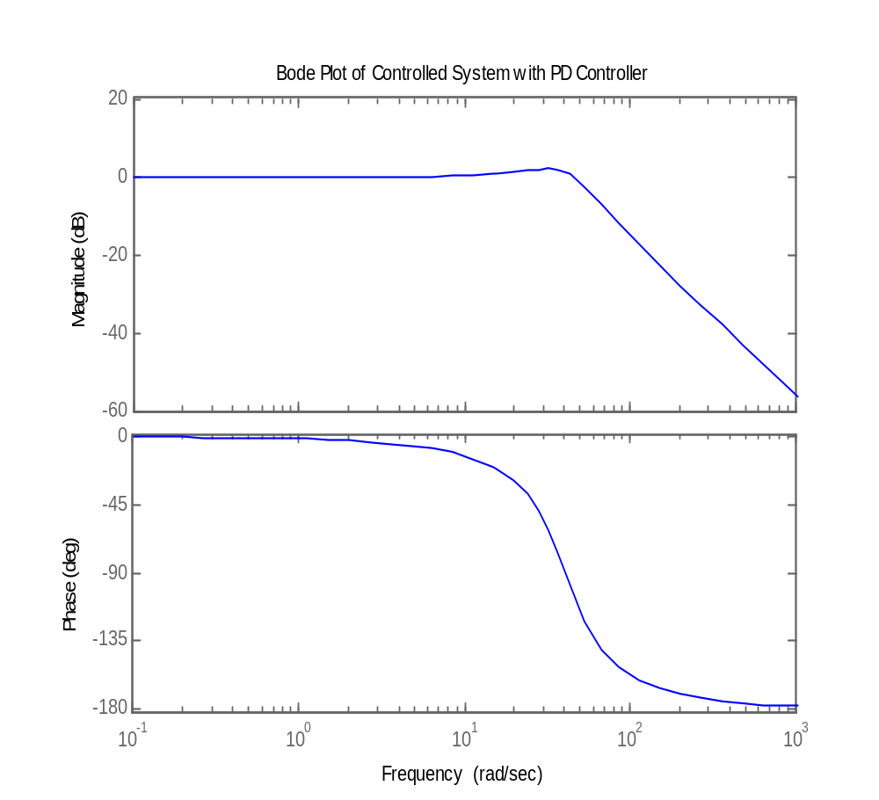
RL & BP of New System
Attenuation frequency range has increased -> Faster system.
GOOD.
Stability is seen for ALL K values. Poles closer to right plane -> Faster system.
GOOD.
TDC1 FALL

Slide 17
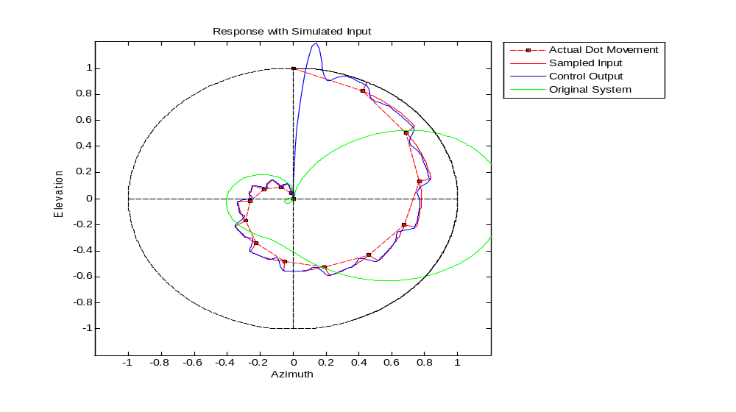
Response with Simulated Input
Input modeled by a decaying unit step response cast to a circle.
Control output follows desired tracking.
Original output loses sight of target.
TDC1 FALL

Slide 18

New Control System Scenario
TDC1 FALL

Slide 19
¿QUESTIONS?
TDC1 FALL

